Slide 1

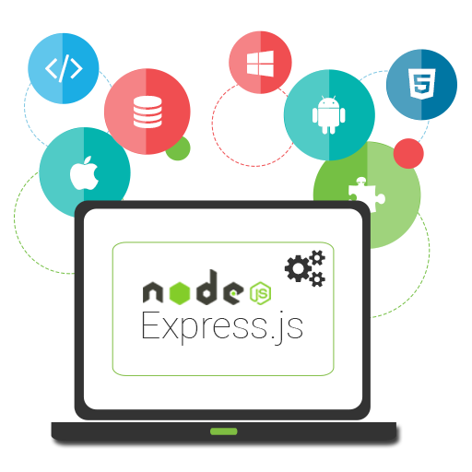


Introduction to Express.js
Working with a framework
Express.js
SoftUni Team
Technical Trainers
Software University
http://softuni.bg

Slide 2

Table of Contents
Introduction to Express.js
Router
Handling a request/response with Express.js
Static Files
Middleware
Custom and Third-Party
REST Services

Slide 3
Have a Question?
sli.do #js-web

Slide 4



Introduction to Express.js
Installation, Configuration, Startup

Slide 5
Visual Studio Code IntelliSense
Install typings globally:
Run the following to install Express.js IntelliSense
npm install typings --g
typings install express --save
Now you have IntelliSense in VS Code

Slide 6
Introduction to Express.js
Install express.js
You can check out http://expressjs.com/en/api.html
npm install express –-save –-save-exact
let express = require('express')
let app = express()
const port = 1337
app.get('/', (req, res) => {
res.status(200)
res.send('Welcome to Express.js!')
})
app.listen(port, () => console.log(`Express running on port ${port}...`))
Create a new instance of the application

Slide 7

Router in Express.js
Handling request/response

Slide 8
Router
Routing has the following syntax
Where:
app is an instance of express
METHOD is an HTTP request method, in lowercase
PATH is a path on the server
HANDLER is the function executed when the route is matched
app.METHOD(PATH, HANDLER)

Slide 9
Route Methods - Example
// GET method route
app.get('/', (req, res) => {
res.send('GET request to the homepage')
})
// POST method route
app.post('/create', (req, res) => {
res.send('POST request to the homepage')
})
// PUT method route
app.put('/modify', (req, res) => {
res.send('PUT request to the homepage')
})

Slide 10
Route Methods – Example 2
// All methods route
app.all('/about', (req, res, next) => {
console.log('Middleware execution..')
next()
}, (req, res) => {
res.send('Show about page.')
})
The next handler to be called
Shows the about page after middleware execution

Slide 11
Router Paths
Paths can contain special characters:
app.get('*',(req, res) => {
res.send('Matches everything')
})
app.get('/ab*cd', (req, res) => {
res.send('abcd, abANYTHINGcd')
})
app.get(/.*fly$/, (req, res) => {
res.send('butterfly, dragonfly')
})
Based on string patterns
Based on regular expressions

Slide 12
Extracting Parameters
Paths can have parameters:
You can also validate parameters with regular expressions
app.get('/users/:userId', (req, res) => {
let paramsObj = req.params
res.send(paramsObj)
})
app.get('/users/:userId(\\d+)', (req, res) => {
let paramsObj = req.params
res.send(paramsObj)
})
Matches only digits

Slide 13
Chainable routes
You can create chainable route handlers using 'app.route()':
app.route('/home')
.get((req, res) => {
res.send('GET home page')
})
.post((req, res) => {
res.send('POST home page')
})
.all((req, res) => {
res.send('Everything else')
})
Better for ordering routes
Always place 'all' as a final method

Slide 14
Router Responses
Responses:
res.download – prompt a file to be downloaded
res.end – end the response process
res.json – send a JSON response
res.jsonp – send a JSON response with JSONP support (cross-domain friendly)
app.get('/pdf', (req, res) => {
res.download('FULL PATH TO PDF')
})

Slide 15
Router Responses
res.redirect – redirect a request (to another page)
res.sendFile – send a file as an octet stream
res.render – render a view template
Additional functions at: https://expressjs.com/en/4x/api.html
app.get('/about/old', (req, res) => {
res.redirect('/about')
})
app.get('/file/:fileName', (req, res) => {
let fileName = req.params.fileName
res.sendFile("PATH TO FILE" + fileName)
})

Slide 16
Modular Routers
You can use express.Router for modular route handlers
Mounted on a route (e.g. '/about')
Can use middleware, specific only to that router
var express = require('express')
var router = express.Router()
router.use(/* add middleware */)
router.get(/* define route handlers */)
app.use('/about', router)

Slide 17
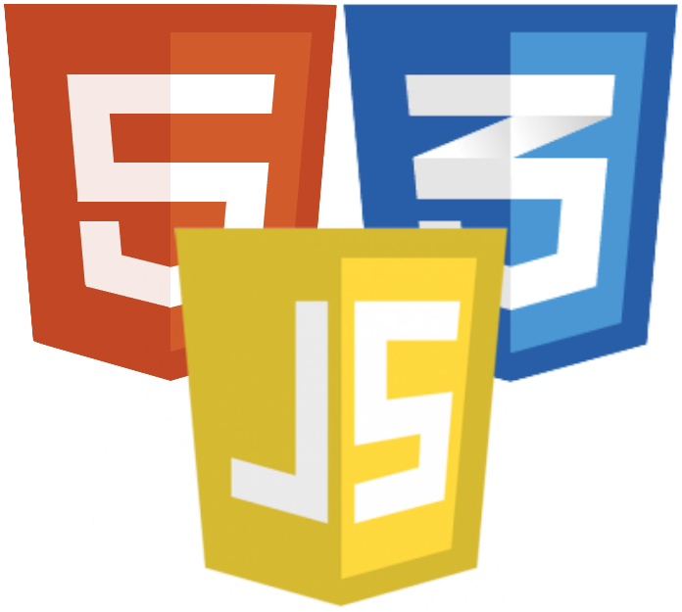
Static Files
Serve HTML, CSS, JS and other

Slide 18
Static Files
Serving static files is easy:
And all files from the directory will be public:
app.use(express.static('public'))
app.use('/static', express.static('public'))
app.use('/static', express.static(__dirname + '/public'))
http://localhost:3000/images/kitten.jpg
http://localhost:3000/css/style.css
http://localhost:3000/js/app.js
http://localhost:3000/images/bg.png
http://localhost:3000/hello.html

Slide 19
Middleware
Client
Database
Middleware
Intercepting the HTTP

Slide 20
Middleware
Middleware is just a function
Can manipulate requests and responses
Different kind of middleware exist
Application, route, error
Example:
var app = express()
app.use((req, res, next) => {
console.log('Time:', Date.now())
next()
})
Next handler to be called

Slide 21
Custom Middleware
Middleware can be only for specific path
app.use('/user/:userId', (req, res, next) => {
let userId = req.params.userId
// TODO: Check if user exists in db/session
let userExists = true
if (!userExists) {
res.redirect('/login')
} else {
next()
}
})
app.get('/user/:userId', (req, res) => {
res.send('User home page!')
})
Custom authentication middleware

Slide 22
Third-Party Middleware
Body parser - https://github.com/expressjs/body-parser
const express = require('express')
const bodyParser = require('body-parser')
const port = 1337
let app = express()
app.use(bodyParser.urlencoded({ extended: true })) app.post('/login', (req, res) => {
console.log(req.body)
res.redirect('/home.html')
})
app.listen(port, () => console.log(`Express running on port ${port}`))

Slide 23
Third-Party Middleware
More available here http://expressjs.com/en/resources/middleware.html
app.set('view engine', 'pug');
app.set('views', __dirname + '/views');
app.use(cookieParser());
app.use(bodyParser());
app.use(session({secret: 'magic unicorns'}));
app.use(passport.initialize());
app.use(passport.session());
app.use(express.static(config.rootPath + '/public'));

Slide 24
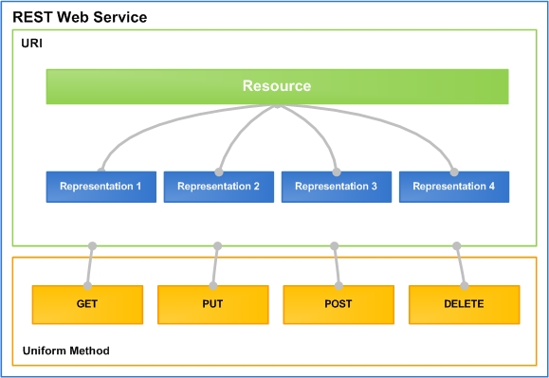
REST and RESTful Services
Representational State Transfer (REST)
Architecture for client-server communication over HTTP
Resources have URI (address)
Can be created / retrieved / modified / deleted / etc.
RESTful API / RESTful Service
Provides access to server-side resources via HTTP and REST

Slide 25


REST and RESTful Services – Example
Create a new post
POST http://some-service.org/api/posts
Get all posts / specific post
GET http://some-service.org/api/posts
GET http://some-service.org/api/posts/17
Delete existing post
DELETE http://some-service.org/api/posts/17
Replace / modify existing post
PUT / PATCH http://some-service.org/api/posts/17

Slide 26
REST Services with Express
Websites that use REST services are more interactive
The client can make AJAX requests without refreshing the page
Necessary for Single Page Application (e.g. using React, Angular…)
Server
Client
GET
Static Files
HTML
POST, PUT, DELETE, …
REST API
JS App

Slide 27
Simple Example
To create endpoint for REST access:
More information here
app.use(bodyParser.urlencoded({ extended: true }));
app.use(bodyParser.json());
const router = express.Router();
router.get('/', function(req, res) {
res.json({ message: 'hooray! welcome to our api!' });
});
router.post('/', function(req, res) {
// Handle client data and respond with JSON
});
// TODO add more actions
app.use('/api', router);

Slide 28
Summary
Express.js is a fast web framework for Node.js
Routing is done with a familiar syntax
Middleware in our application (custom, third-party)
REST services allow resources to be served to applications
app.METHOD(PATH, HANDLER)
app.use(bodyParser());

Slide 29












Express.js
https://softuni.bg/trainings/courses/

Slide 30





Trainings @ Software University (SoftUni)
Software University – High-Quality Education, Profession and Job for Software Developers
softuni.bg
Software University Foundation
http://softuni.foundation/
Software University @ Facebook
facebook.com/SoftwareUniversity
Software University Forums
forum.softuni.bg

